Slide 1
Electrical Circuits Power Calculation
Section 1.1, 1.2, 1.3, 1.4, 1.5, 1.6 from Fundamentals of Electric Circuits (5th Edition) by Alexandar and Sadiku
Md. Shafqat Talukder Rakin
Lecturer, Department of CSE,
United International University
Email id : shafqat@cse.uiu.ac.bd
Courtesy: Rifat Bin Rashid

Slide 2
Independent Power Sources
An ideal independent source is an active element that provides a specified voltage or current that is completely independent of other circuit elements.
An active element is one that can generate energy
A passive element is one that cannot generate energy

Slide 3
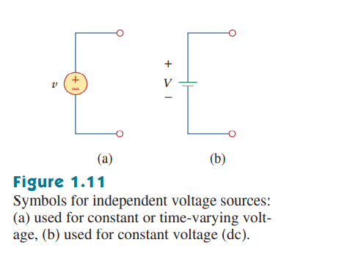
Independent Voltage Sources
Independent Voltage Sources provide a specified amount of voltage, irrespective of other circuit parameters
It provides necessary amount of current to the circuit to maintain its voltage supply

Slide 4
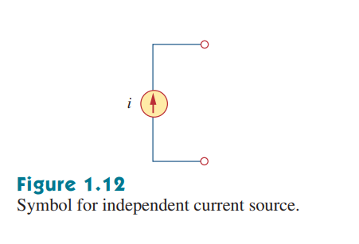
Independent Current Source
Provides a specific amount of current to the circuit
It maintains necessary voltage to provide the specified amount of current

Slide 5
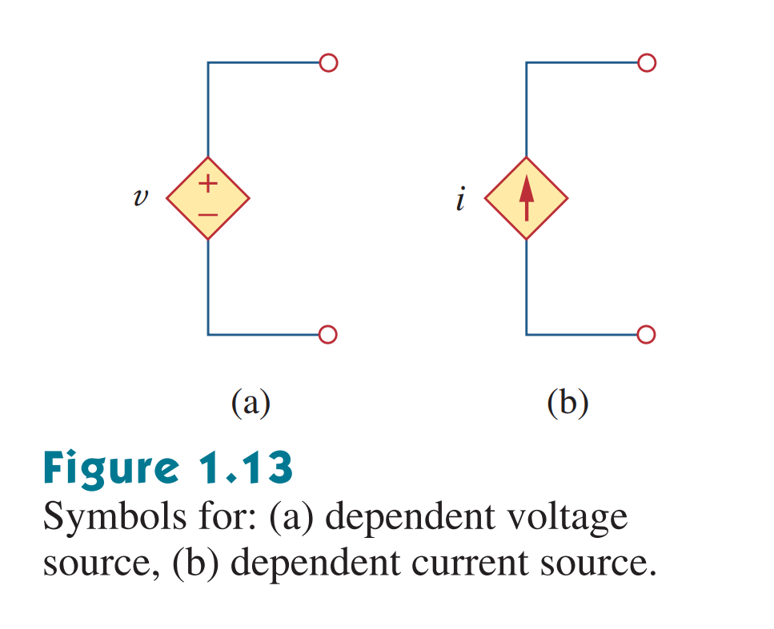
Dependent Source
An ideal dependent (or controlled) source is an active element in which the source quantity is controlled by another voltage or current.

Slide 6
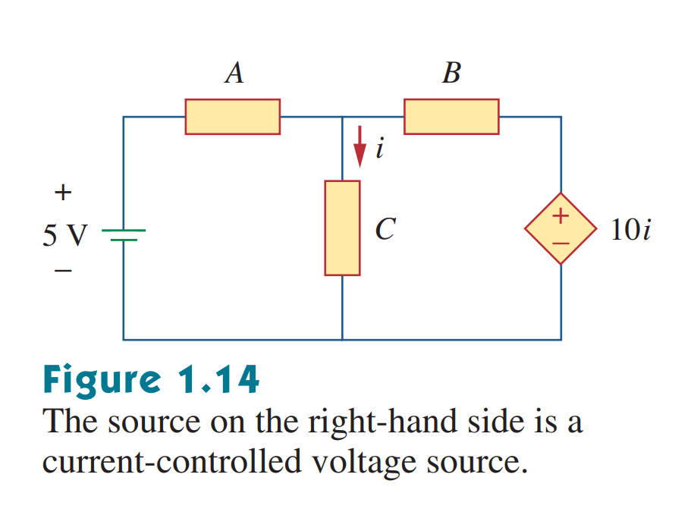
Example of a dependent source
The source on the right is:
A dependent source (It is in a diamond shape)
A voltage source (It has +/- terminals marked on it)
The value on its label (10i) is the voltage of the source, and not the current (Since it is a voltage source)
The source depends on the current of the middle branch (i). So, it is a current controlled source.

Slide 7

Types of Dependent Sources
There are four possible types of dependent sources, namely:
A voltage-controlled voltage source (VCVS).
A current-controlled voltage source (CCVS).
A voltage-controlled current source (VCCS).
A current-controlled current source (CCCS).

Slide 8
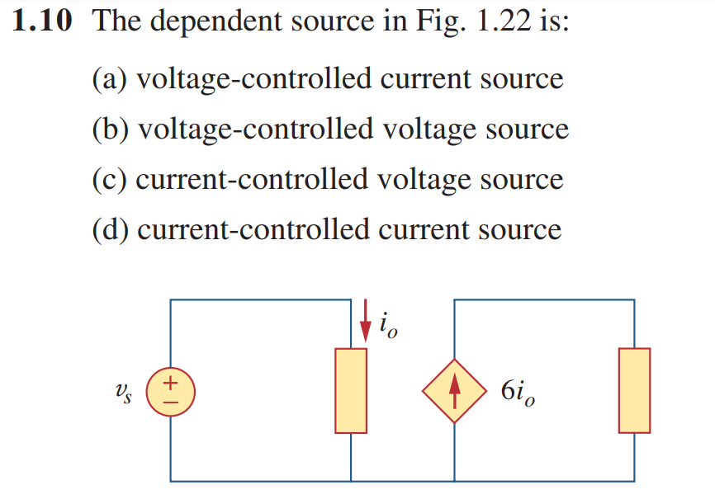
Types of Dependent Sources

Slide 9

Types of Dependent Sources

Slide 10
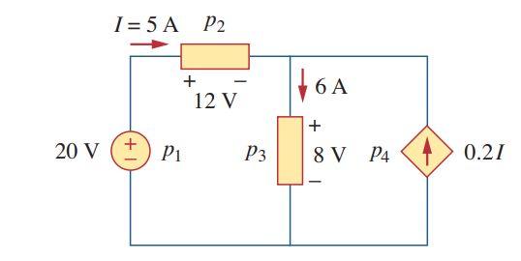
Math Problem Practice:
Calculate the power supplied or absorbed by each element:

Slide 11
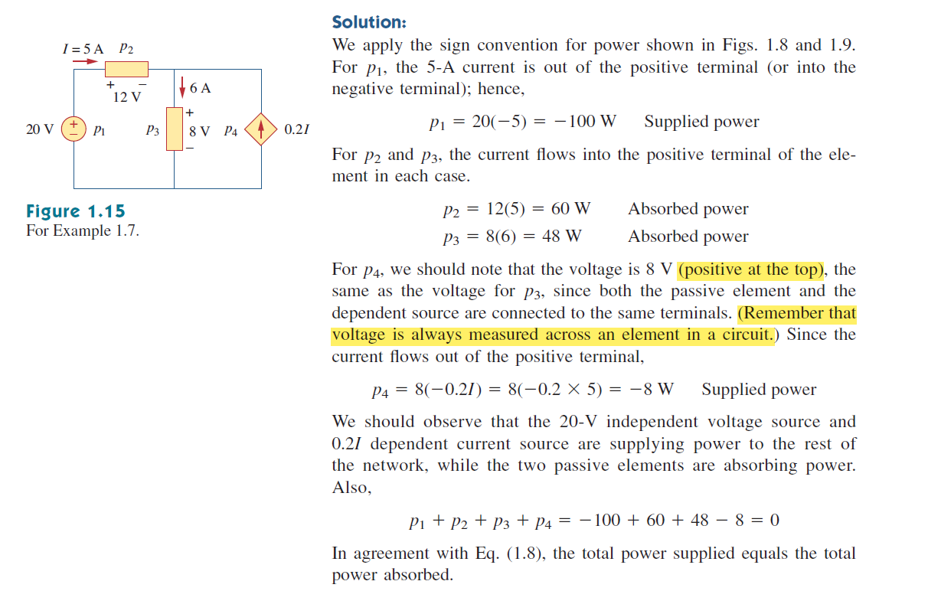

Slide 12
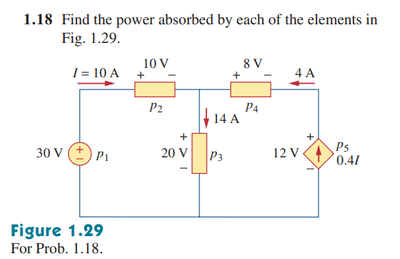
Math Problem Practice:

Slide 13
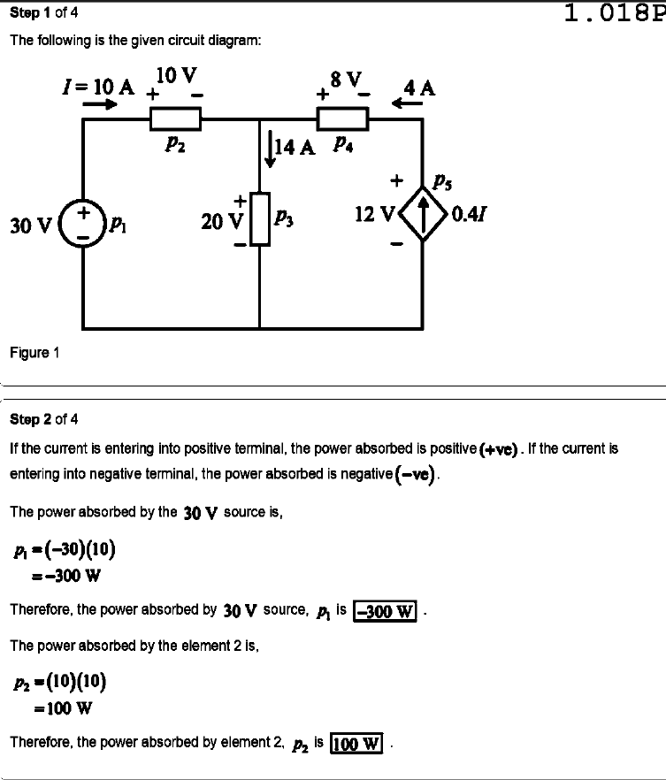
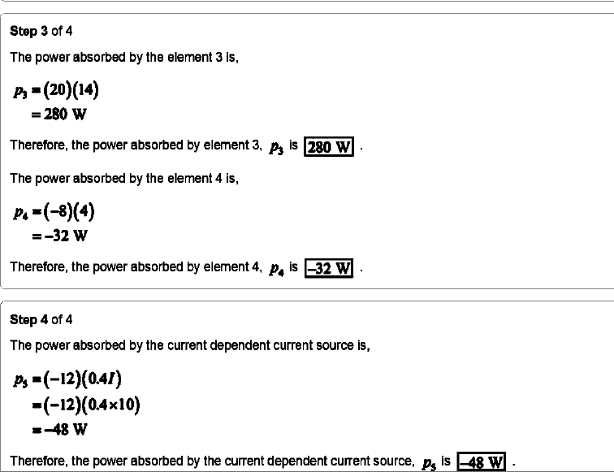

Slide 14
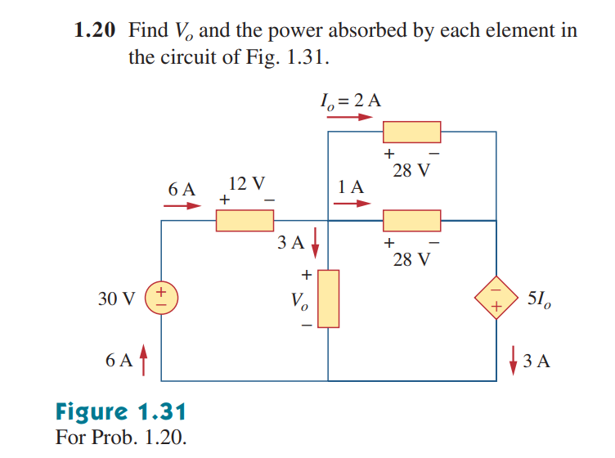
Math Problem Practice:

Slide 15
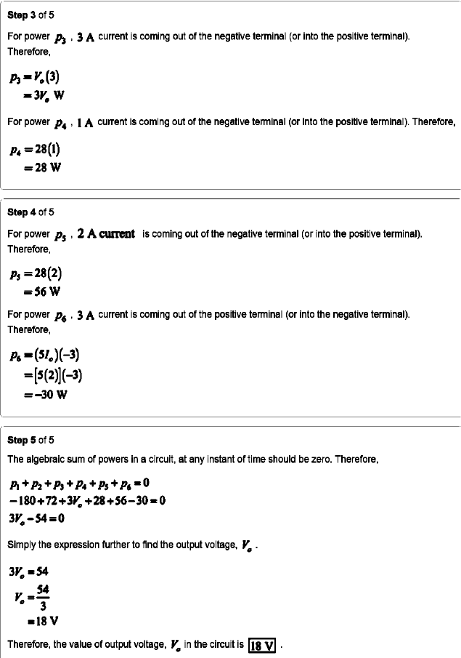
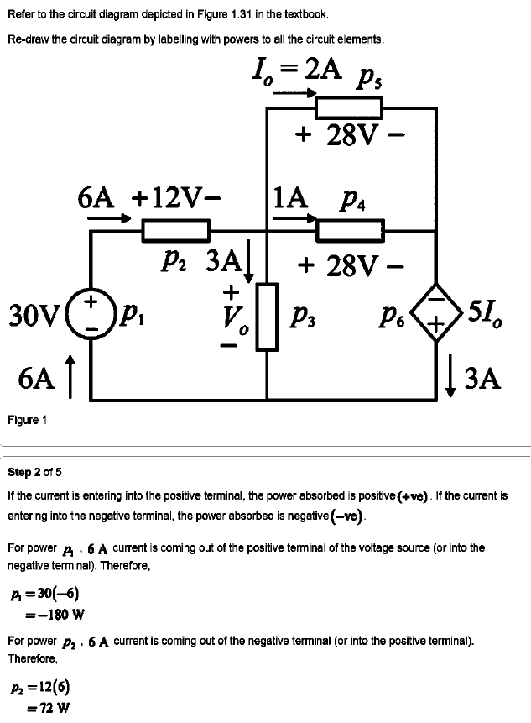

Slide 16
Math to Practice from the Book for Exam
Chapter 1
Example:
1.2, 1.3, 1.4, 1.5, 1.7
Practice Problem:
1.2, 1.3, 1.4, 1.5, 1.7
Problem:
1.2(from a to e), 1.3 (a, b & c), 1.6, 1.7, 1.8, 1.9, 1.11, 1.12, 1.13, 1.16, 1.18, 1.19, 1.20

Slide 17
Thank you

